Slide 1
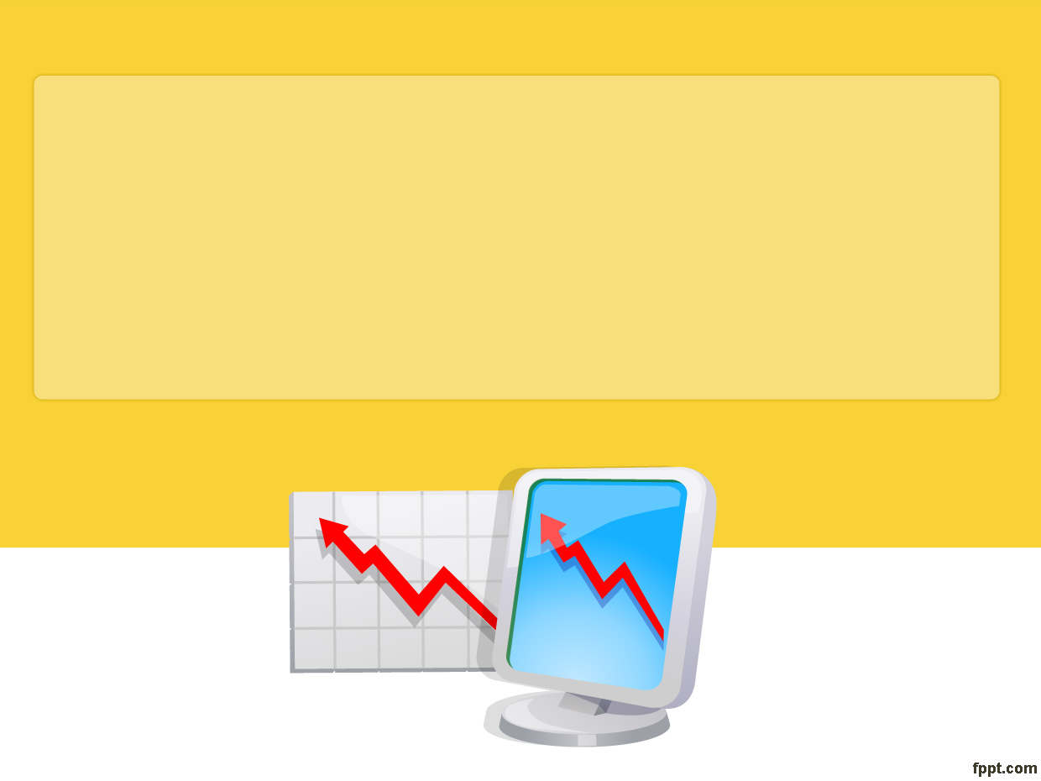
Stock Market Predictive Modeling Spanning the COVID-19 Global Pandemic
- PROJECT 4 -

Slide 2
TEAM MEMBERS
DARIO MICUCCI
BRETT CHAU-DANG
JUSTIN BUTLER
REBECA PEREZ
RON BRENNAN

Slide 3
THE QUESTION
THE QUESTION OUR TEAM SET OUT TO ANSWER WAS:
THE CONTINUED IMPACT OF COVID-19 ON STOCK MARKET PERFORMANCE

Slide 4



STOCKS CHOSEN
These stocks are listed on the NASDAQ Exchange

Slide 5
DATA
THE STOCK DATA WAS RETRIEVED FROM YAHOO FINANCE for the selected stocks.
THE TIME FRAME SELECTED WAS SPRING 2018 TO FALL 2023 FOR A TOTAL OF NUMBER OF DATAPOINTS:
– 1405 DATAPOINTS
– 1405 DATAPOINTS
  – 1324 DATAPOINTS

Slide 6
EXTRACT-TRANSFORM-LOAD
The data for each stock was extracted and saved as a .csv file.
Each .csv file was then imported into a hosted MySQL Database for data integrity (everyone using the same data source)
The data was extracted, then converted into dataframe(s)

Slide 7
THE MACHINE MODELS
THE PREDICTIVE MODELS USED:
ARIMA
XGBOOST
ARTIFICIAL NEURAL NETWORK FOR REGRESSION

Slide 8

ARIMA

Slide 9
XGBOOST

Slide 10
ARTIFICIAL NEURAL NETWORK FOR REGRESSION

Slide 11
SUMMARY
ANSWER TO THE QUESTION

Slide 12
CHALLENGES
MODEL SELECTIONS
COMPLEXITY AND SHAPE OF THE DATA
LIMITED EXPERIENCE LEVEL OF MODELS
MORE ADVANCED ENGINEERED FEATURES REQUIRED

Slide 13
FURTHER ANALYSIS
USE THE LSTM MODEL
INVESTIGATE STOCK PERFORMANCE WITH FACTORS THAT WAS NOT EFFECT

Slide 14
RESOURCES
THE FOLLOWING RESOURCES WERE LEVERAGED IN THIS PROJECT
YAHOO FINANCE - https://ca.finance.yahoo.com/
TUTORS
KAGGLE
MYSQL
TABLEAU

